Slide 1
Bridge Cleaning and Preventive Maintenance
By
Tom Mathews and Mike Baase

Slide 2
Objective
To add to service life to existing bridges with simple and cost effective means.
All preventive maintenance items can be achieved either with in-house forces or by contract.
Average cost per bridge by contract ~ $15,000

Slide 3
PREVENTIVE MAINTENANCE WORK ITEMS
BY
TOM MATHEWS

Slide 4
SCOPE OF WORK
DEBRIS REMOVAL
STRATIFIED AND PACK RUST REMOVAL
PRESSURE WASHING
APPLICATION OF CONCRETE COATINGS
APPLICATION OF BEARING LUBRICATION
APPLICATION OF RUST INHIBITOR

Slide 5
OPTIONAL ITEMS
JOINT SEAL REPLACEMENT IF NECESSARY
VEGITATION REMOVAL IF NECESSARY
DRAIN CLEANING IF APPLICABLE

Slide 7
DEBRIS REMOVAL STRATIFIED RUST REMOVAL PRESSURE WASHING
REMOVAL OF ALL DEBRIS FROM SUBSTRUCTURE CAPS
REMOVAL OF ALL DEBRIS FROM GUTTERS
REMOVAL OF ALL DEBRIS FROM JOINTS
REMOVAL OF ALL DEBRIS FROM DECK DRAINS
REMOVAL OF ALL STRATIFIED RUST ~ SSPC SP-2

Slide 8
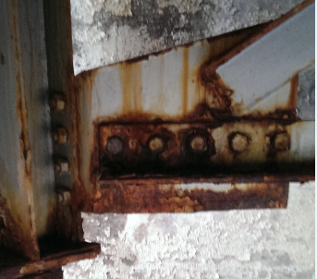

Slide 9
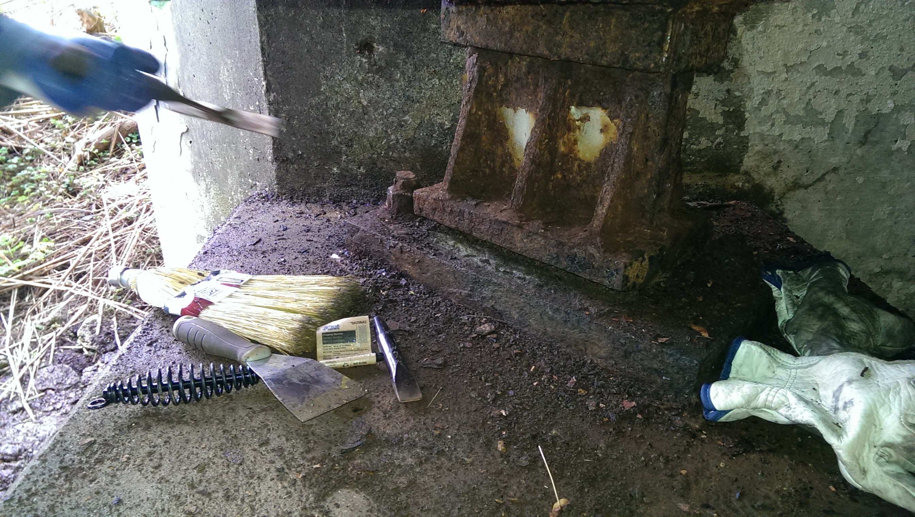

Slide 10
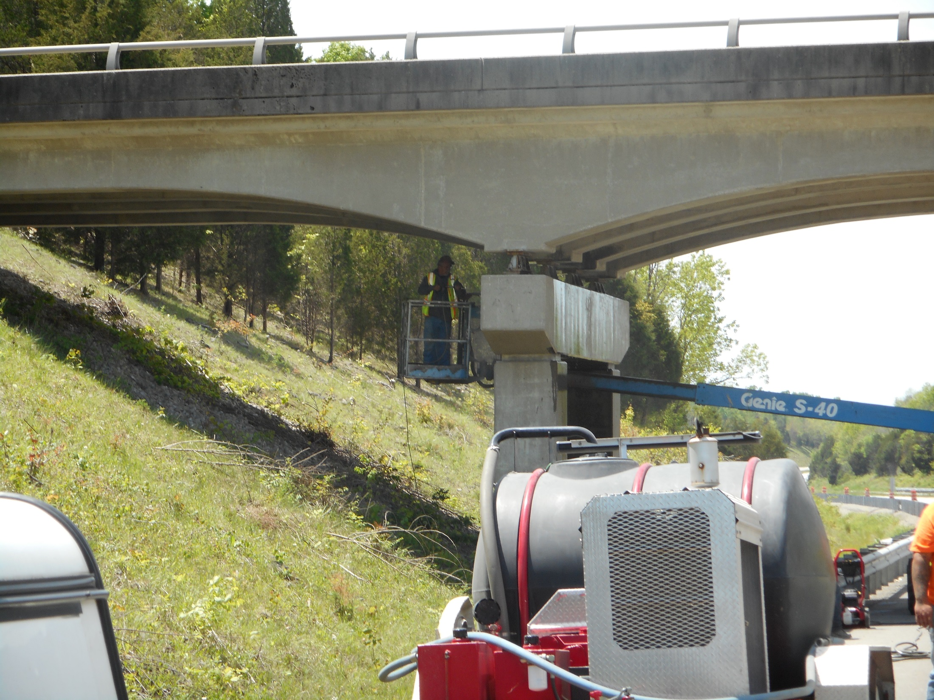

Slide 11
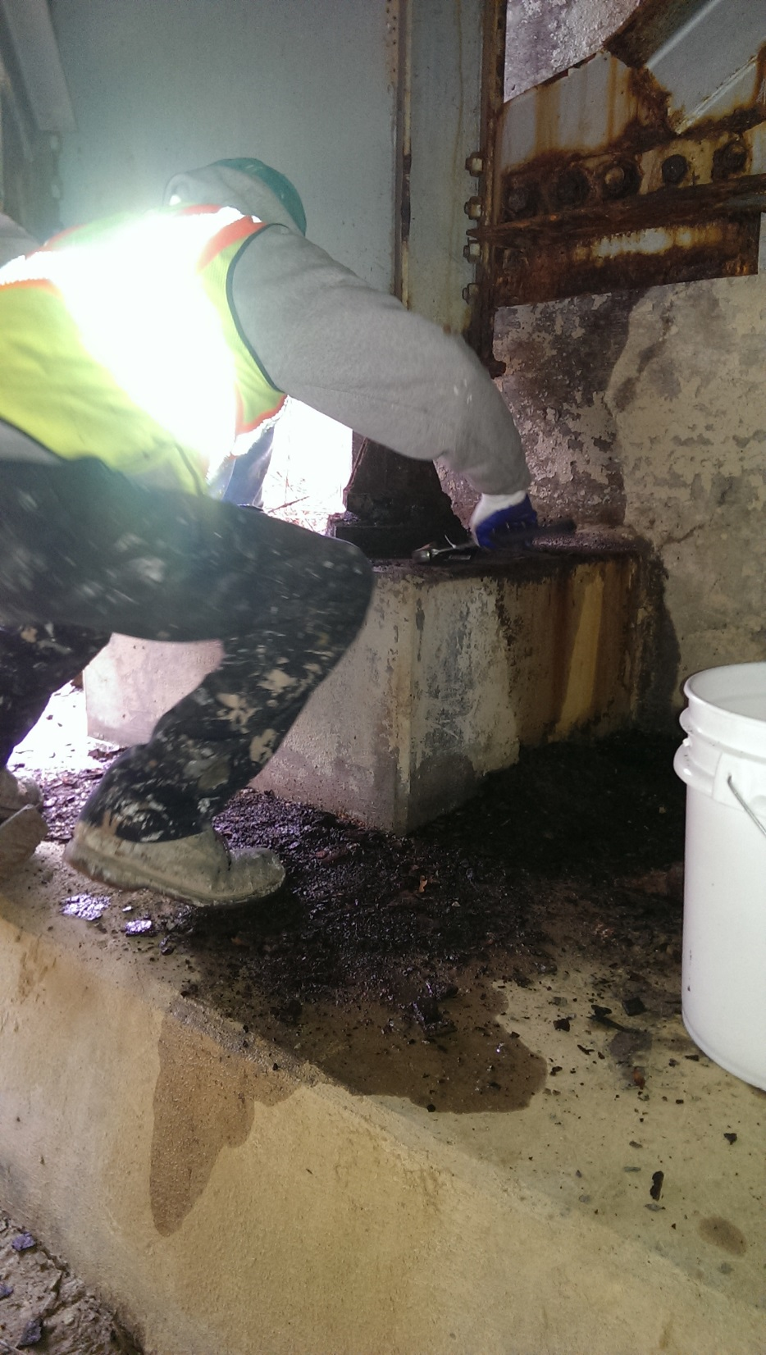
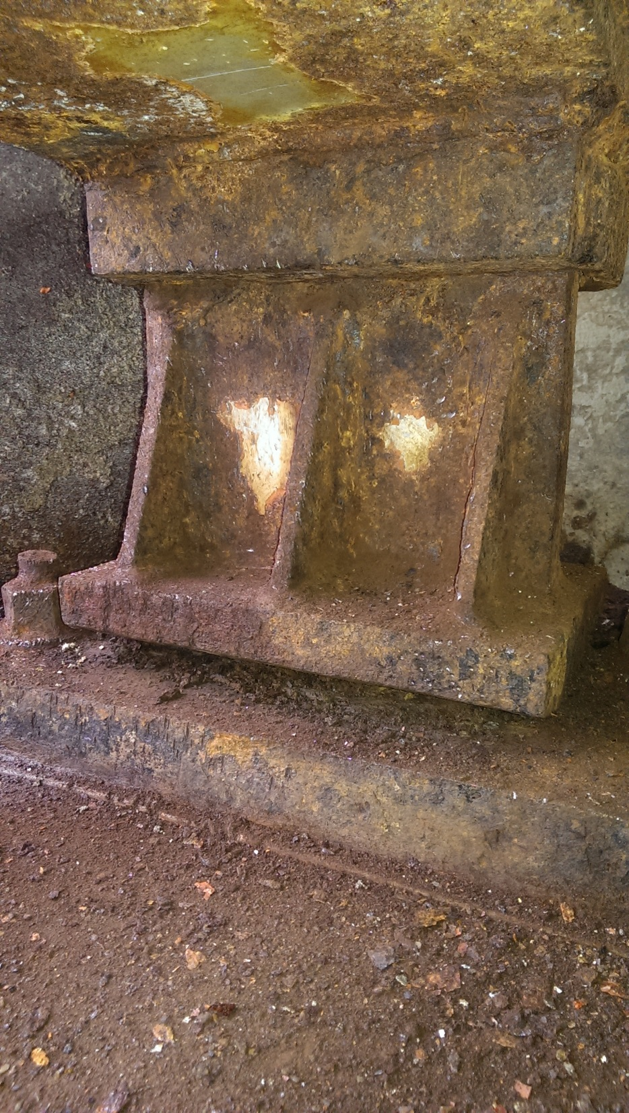

Slide 12
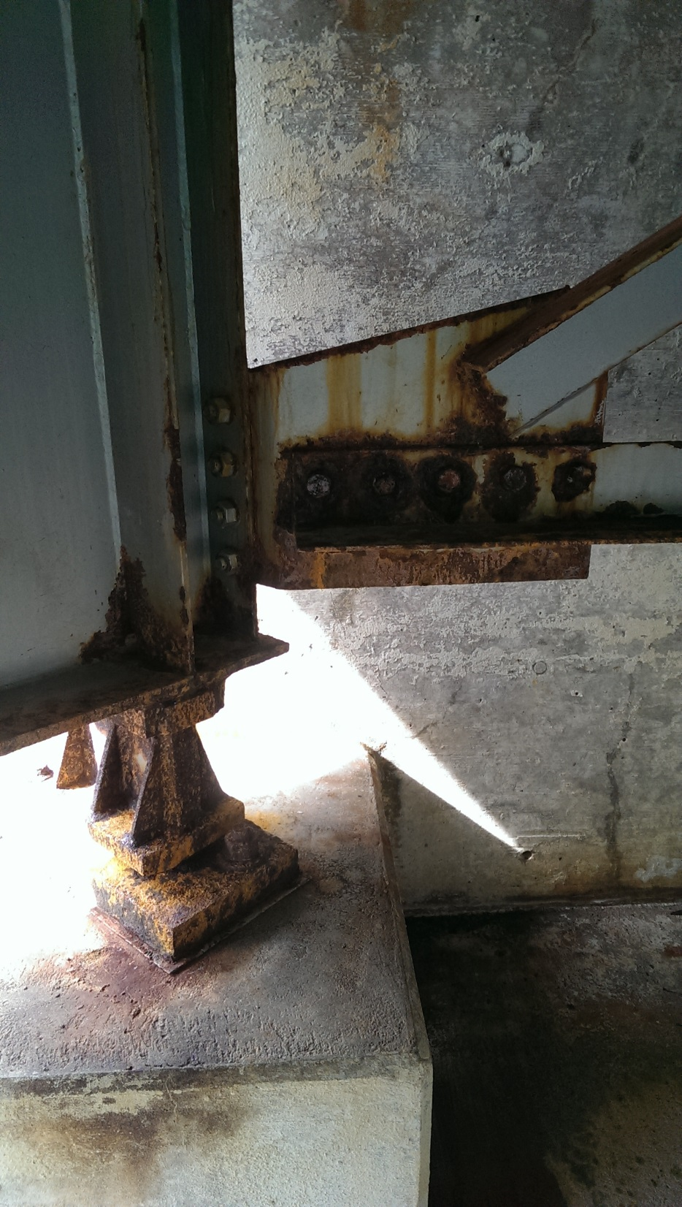
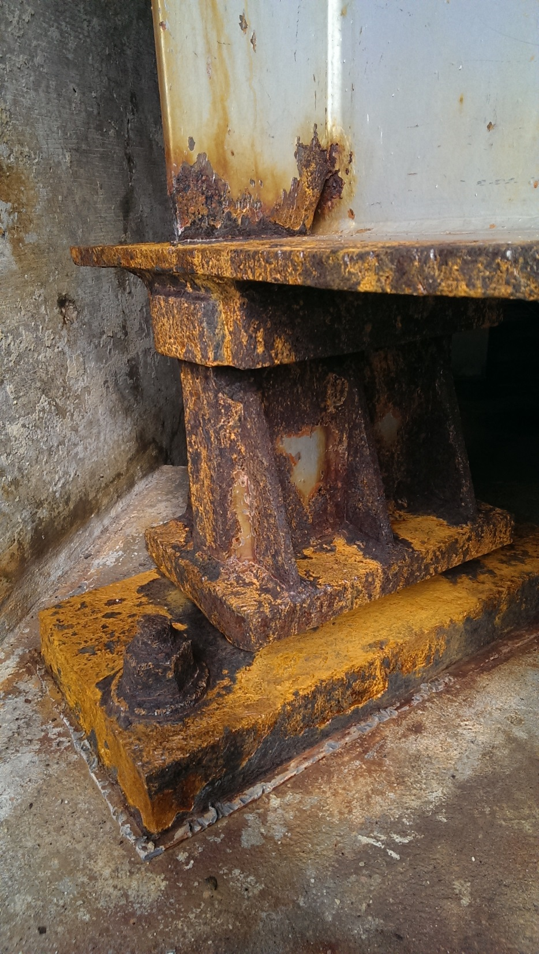

Slide 13
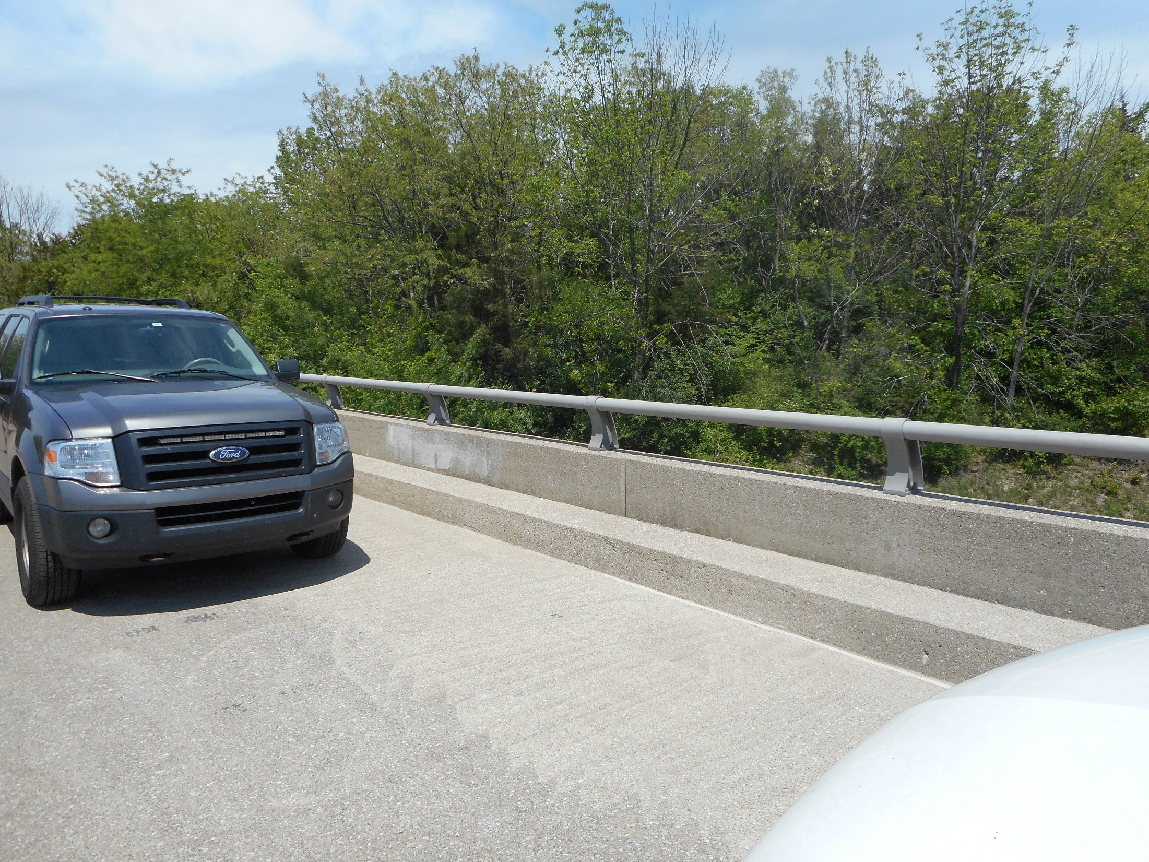

Slide 14
CONCRETE COATINGS, BEARING LUBRICATION AND RUST INHIBITOR APPLICATION
CONCRETE COATINGS APPLIED TO ALL SUBSTRUTURE CAPS AND ENDWALLS
CONCRETE COATINGS APPLIED TO INSIDE FACES OF PARAPATE WALLS
LUBRICATION APPLIED TO ALL MOVABLE BEARINGS
RUST INHIBITOR APPLIED TO RUSTED AREAS OF STRUCTURAL STEEL

Slide 15
CONCRETE COATING MANUFACTURES
SHERWIN WILLIAMS
PRIMER ~ MACROPOXY 646
FINISH ~ ACROLON 218 HS
PPG
PRIMER ~ AMBERLOCK 2
FINISH ~ DEVOE DEXFLEX HP

Slide 16
CONCRETE COATING MANUFACTURES
CARBOLINE
PRIMER ~ CARBOGUARD 890
FINISH ~ CARBOTHANE 133 HB
TNEMEC
PRIMER ~ ELSTOGRIP 151
FINISH ~ ENVIROCRETE 156

Slide 17
BEARING LUBRICATION MANUFACTURES
BOSTIK ~ NEVER SEEZ – MARINER’S CHOICE
MOBIL OIL ~ MOBIL CENTAUR MOLY NLGI
CERTIFIED LABS ~ PERMALUBE #1 WG

Slide 18
RUST INHIBITOR MANUFACTURE
RHOMAR ~ BLACK MAX

Slide 19
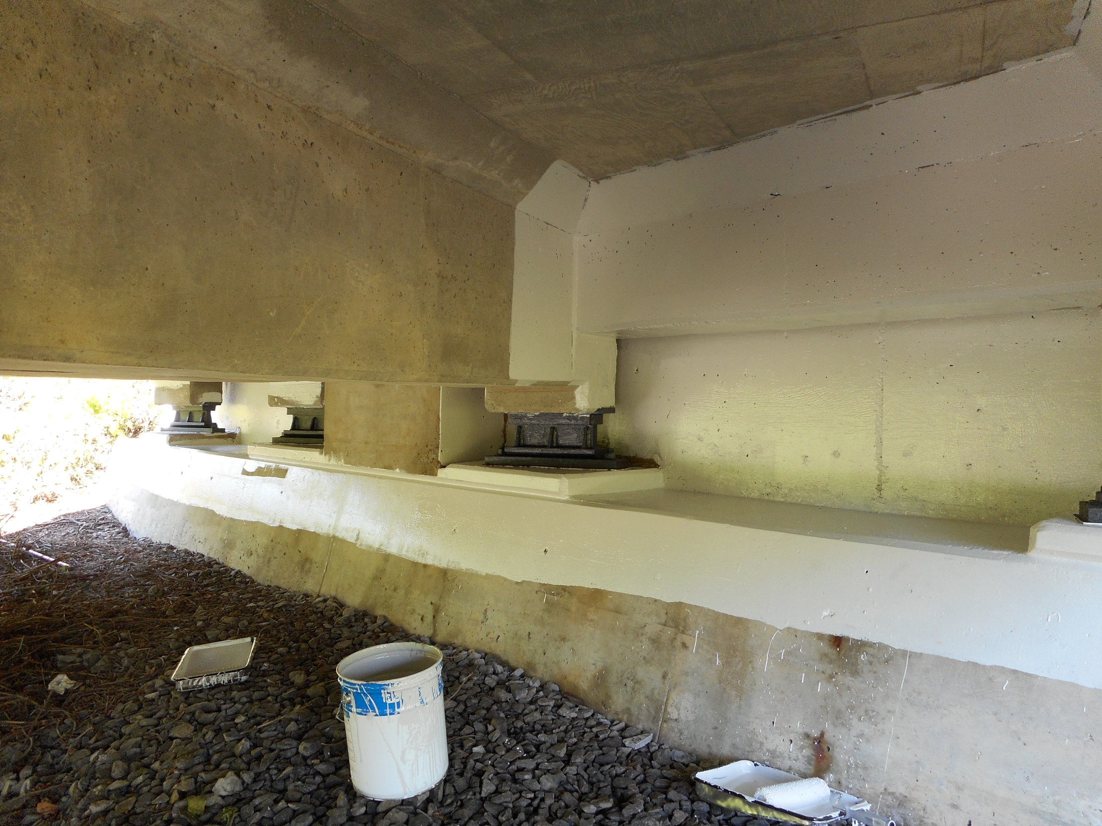

Slide 20
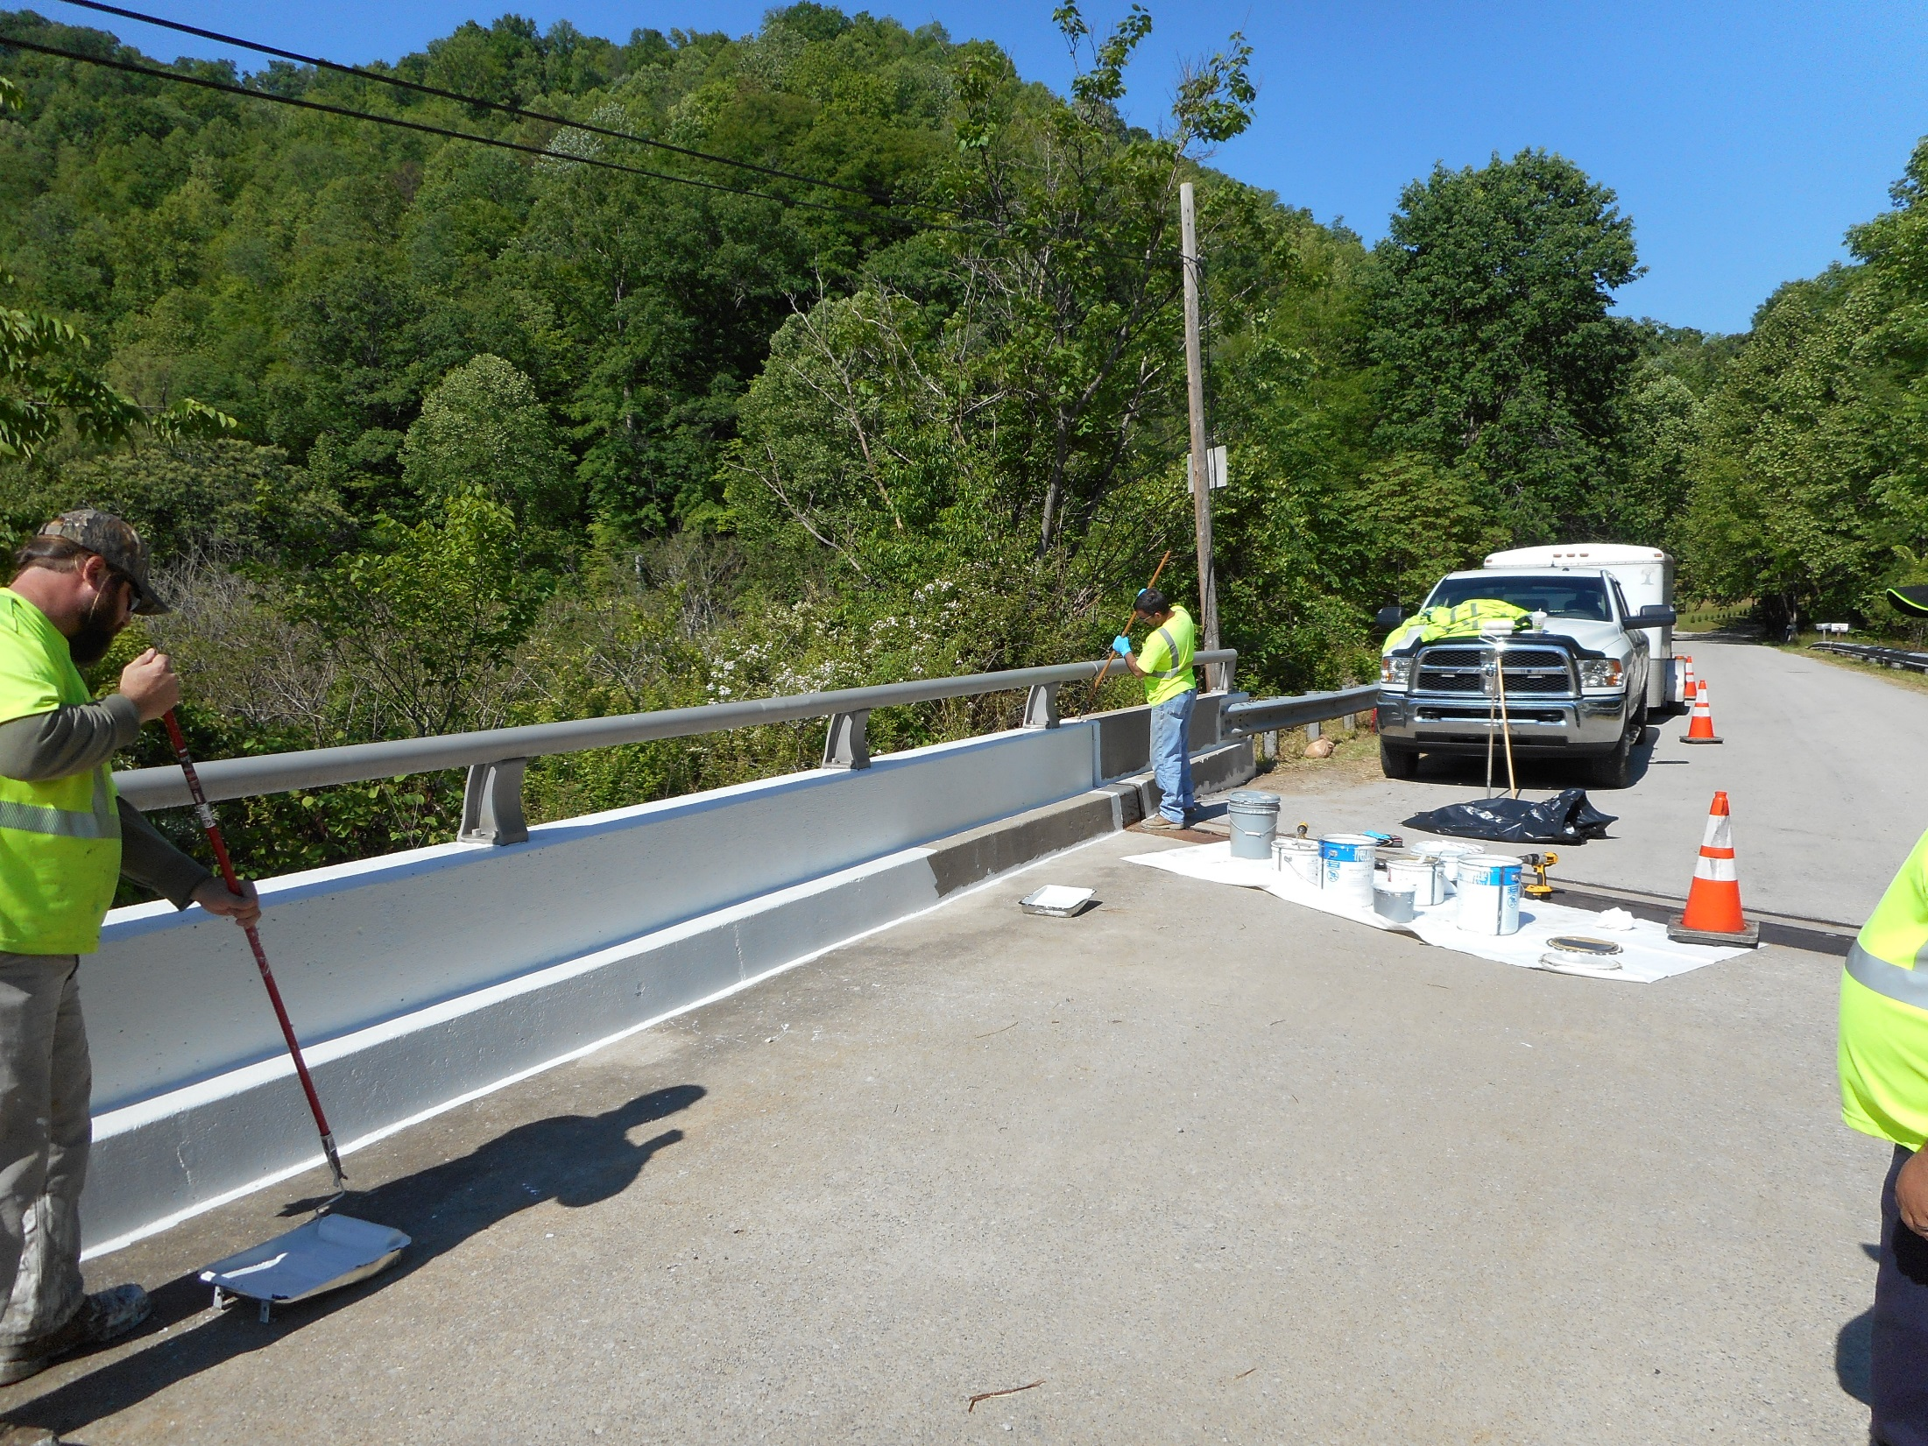

Slide 21
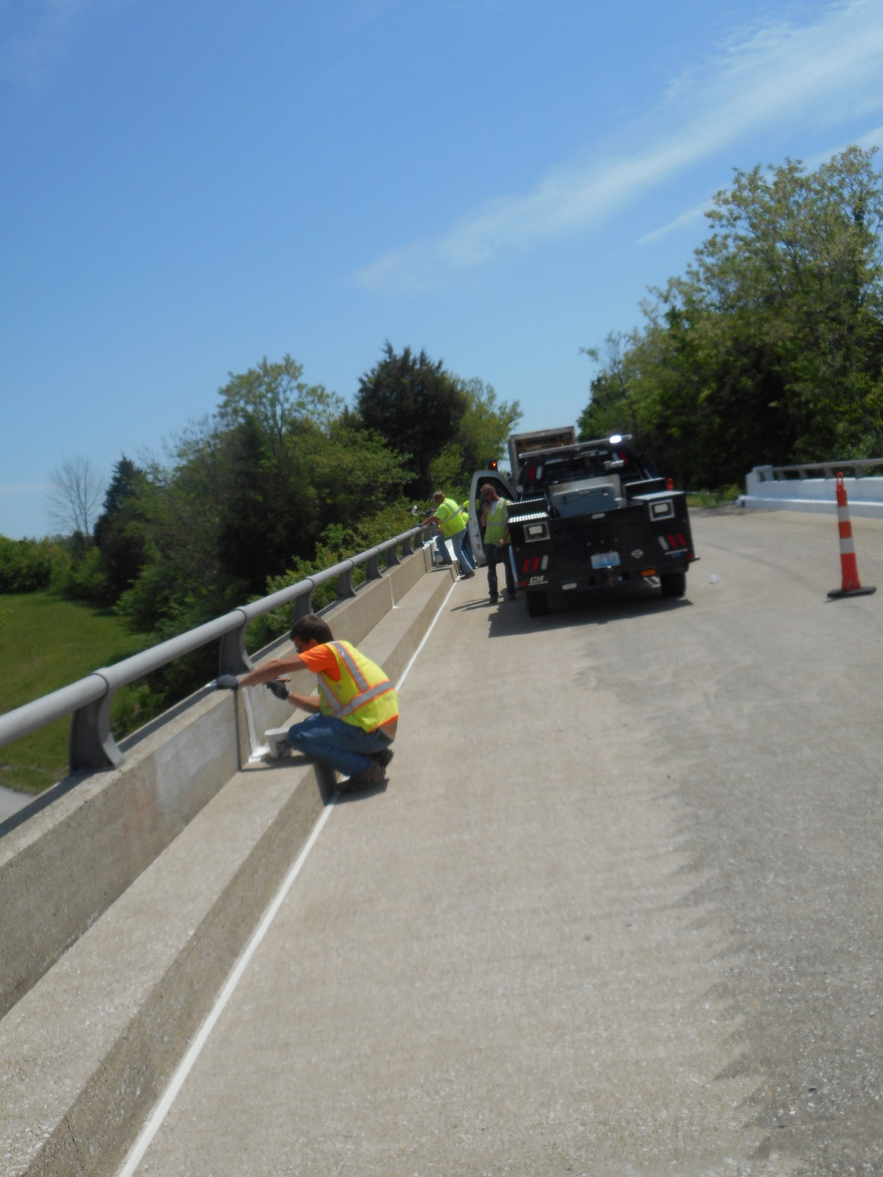

Slide 22
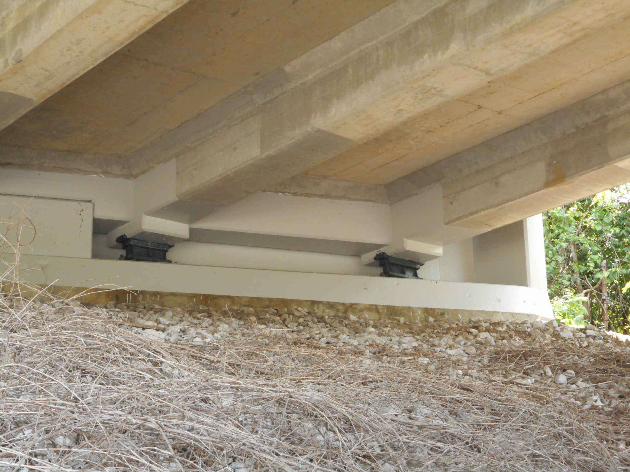

Slide 23
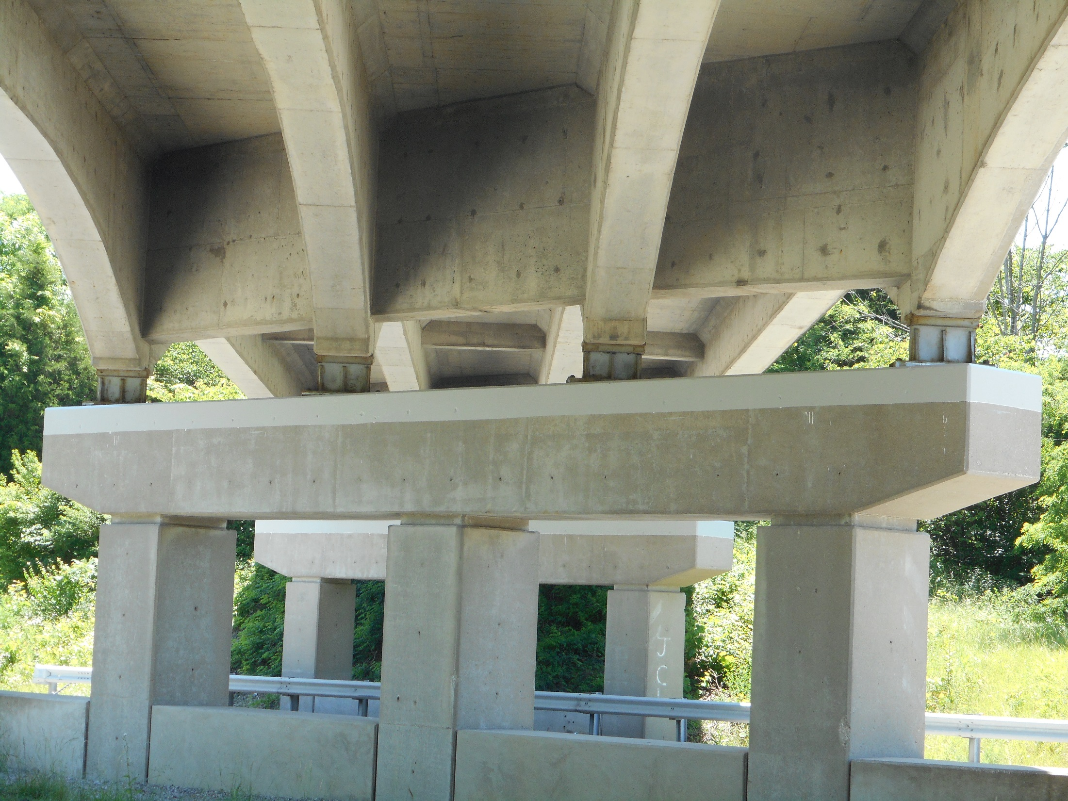

Slide 24
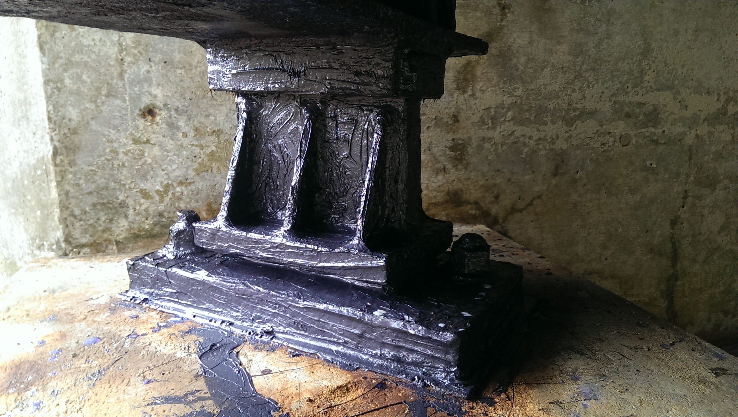

Slide 25
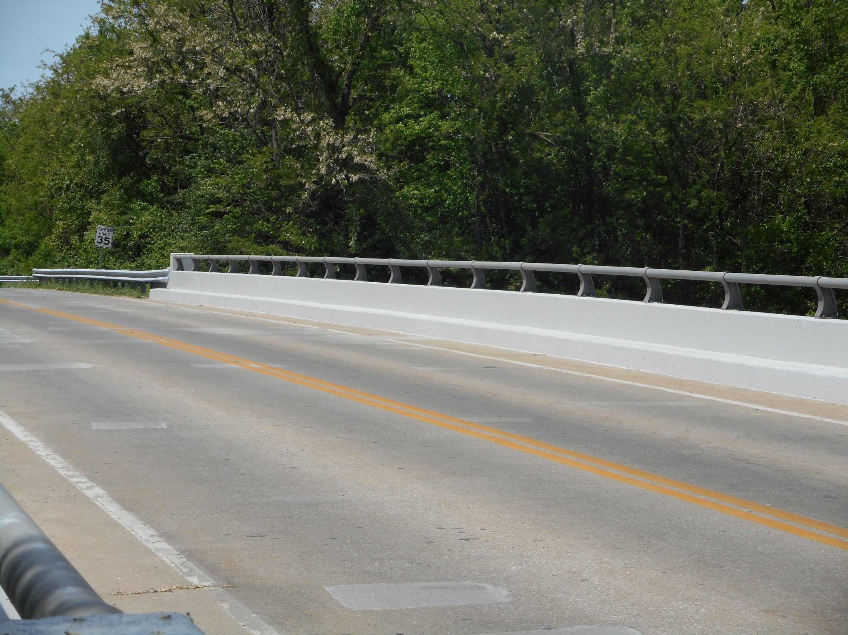

Slide 26
FUN COLORS
INCLUDED IN A CLEANING AND PAINING CONTRACT
ALL STRUCTURAL STEEL CLEANED PAINTED
ALL EXPOSED CONCRETE SUFACES CLEANED AND PAINTED

Slide 27
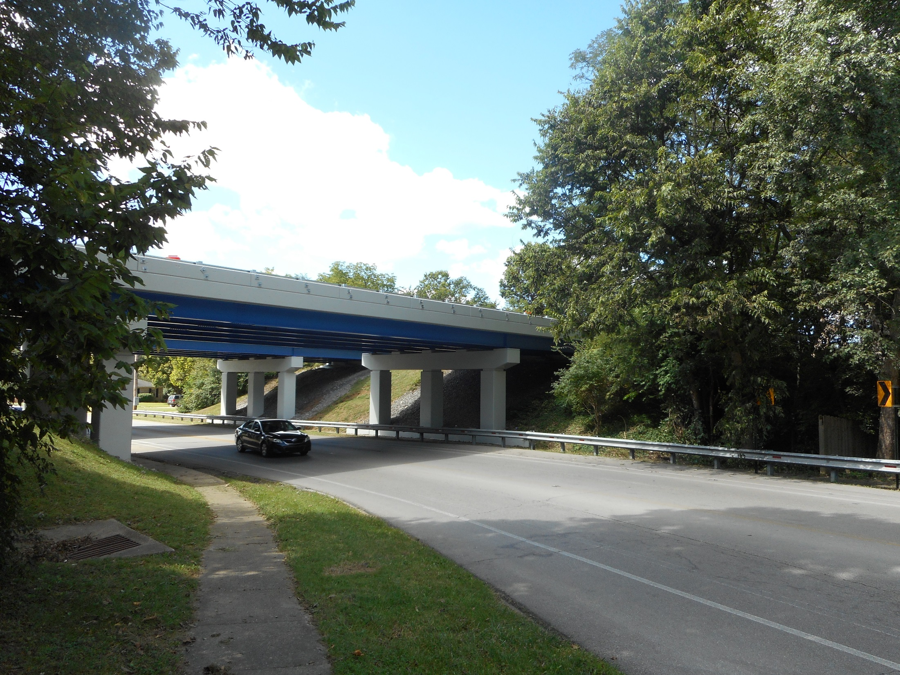

Slide 28
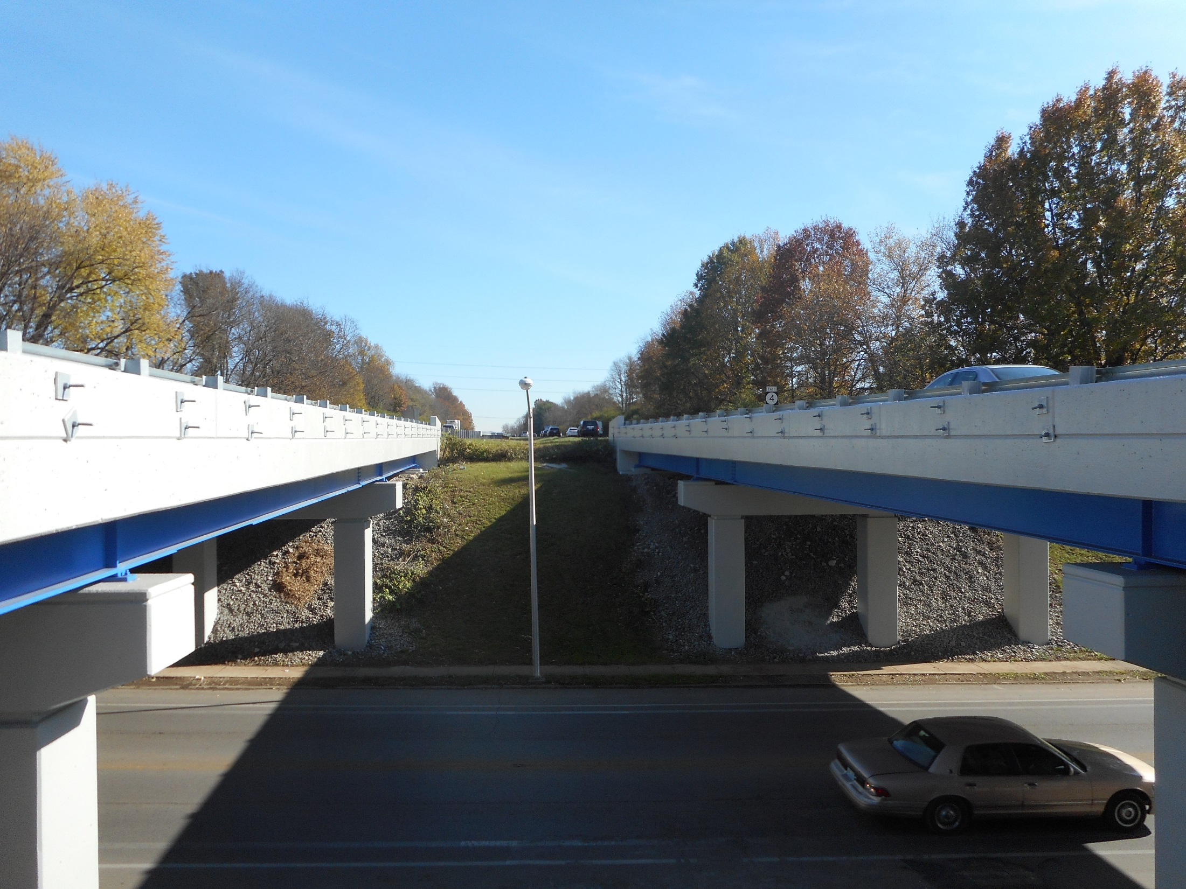

Slide 29
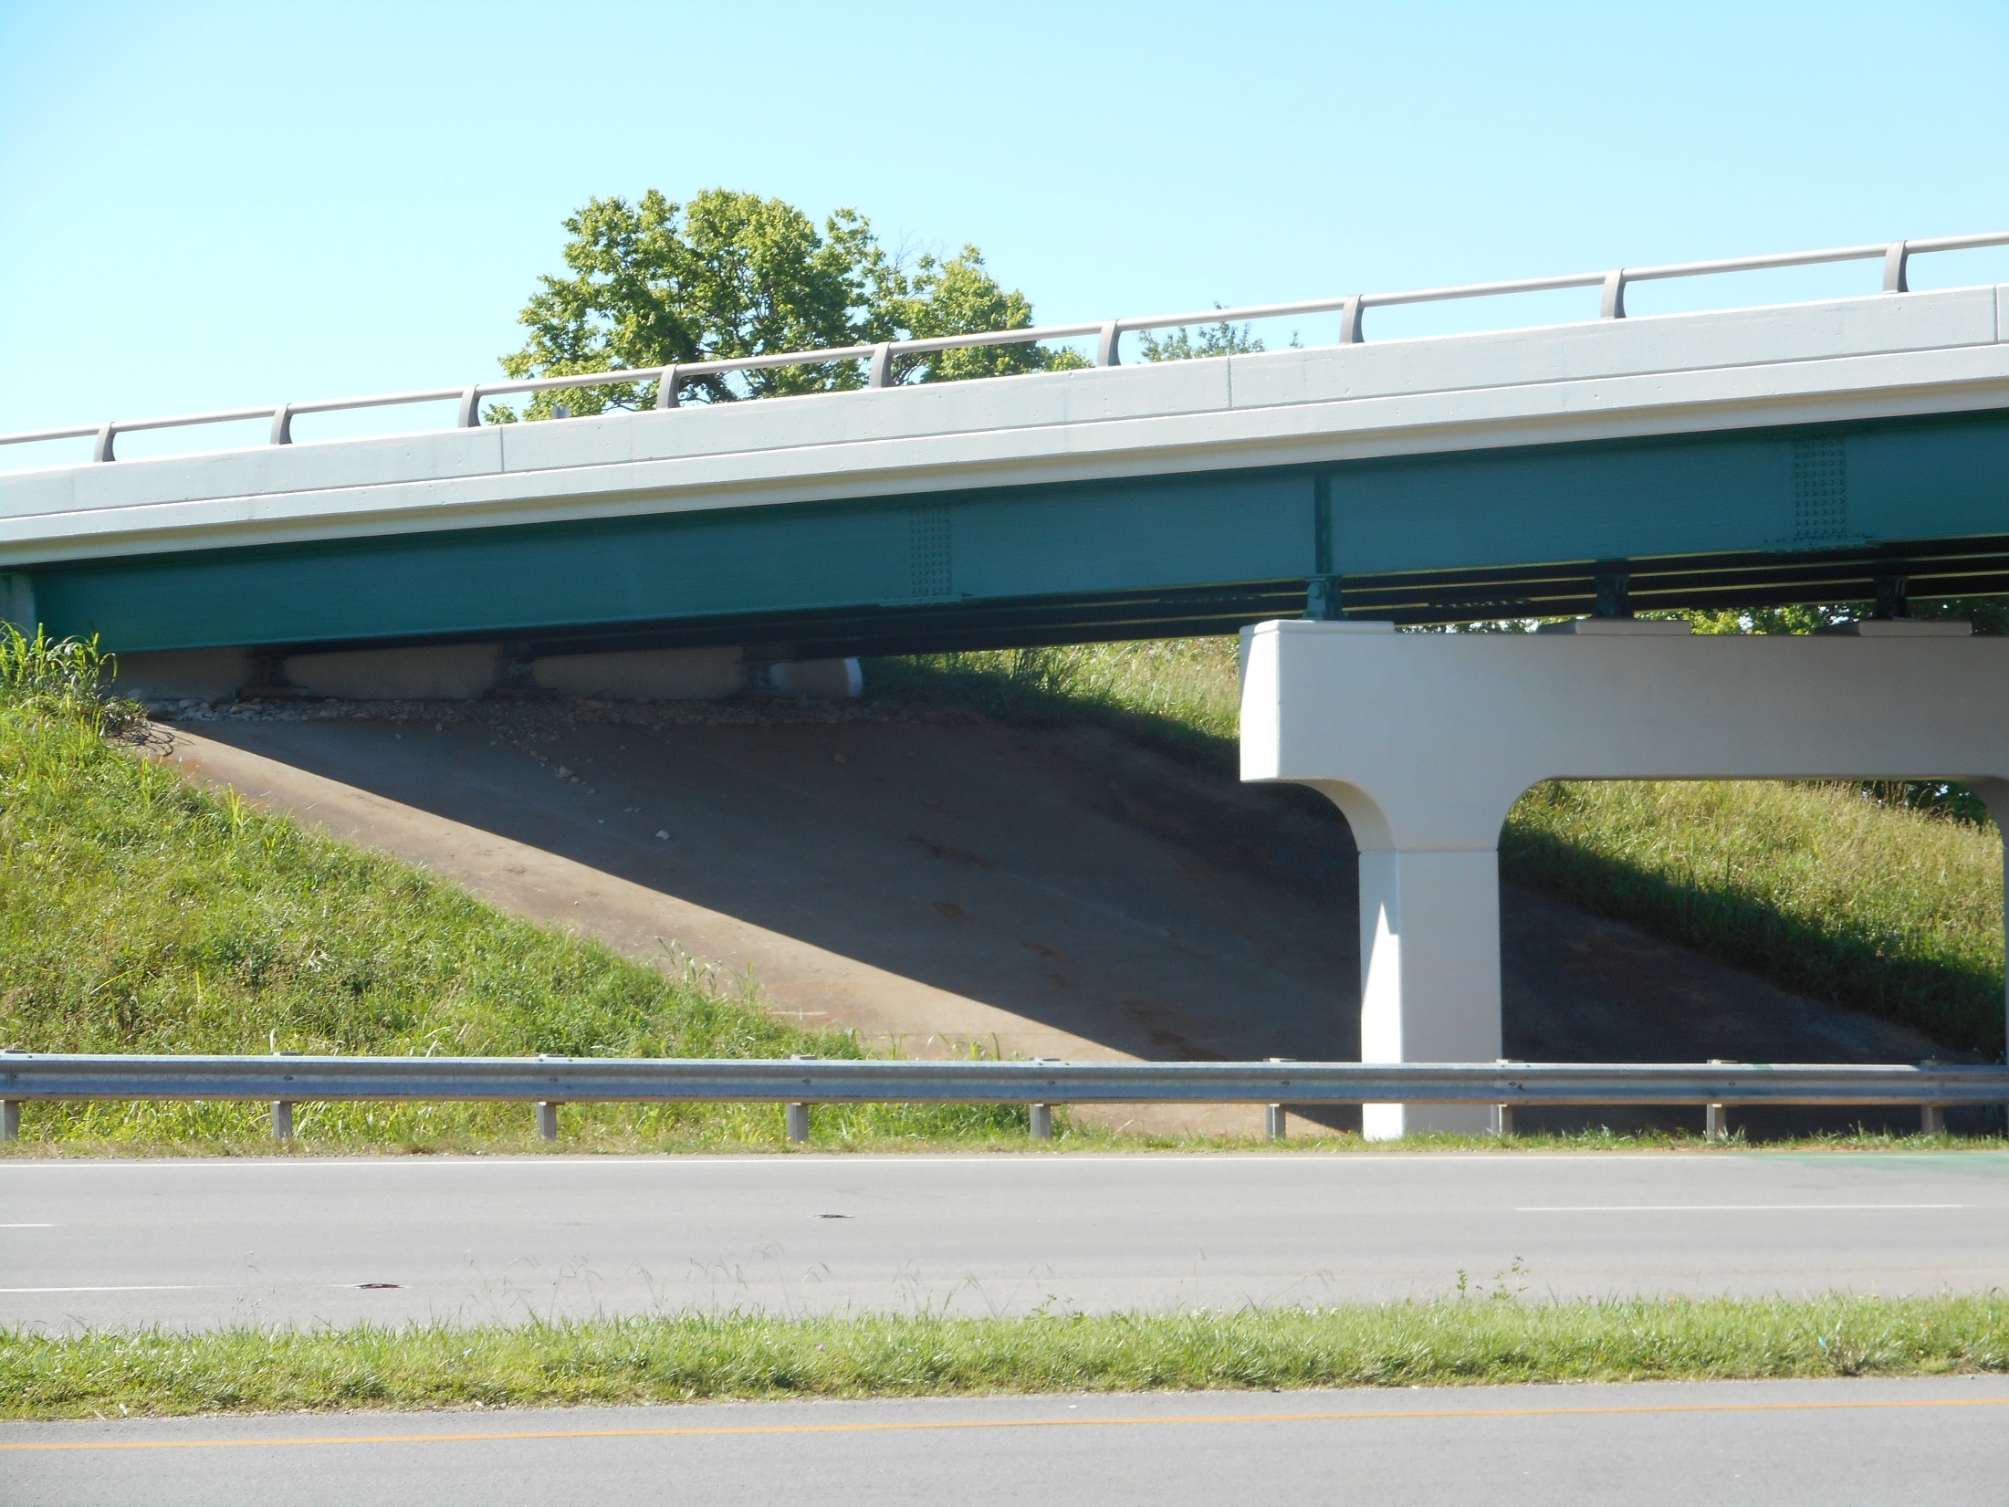

Slide 30
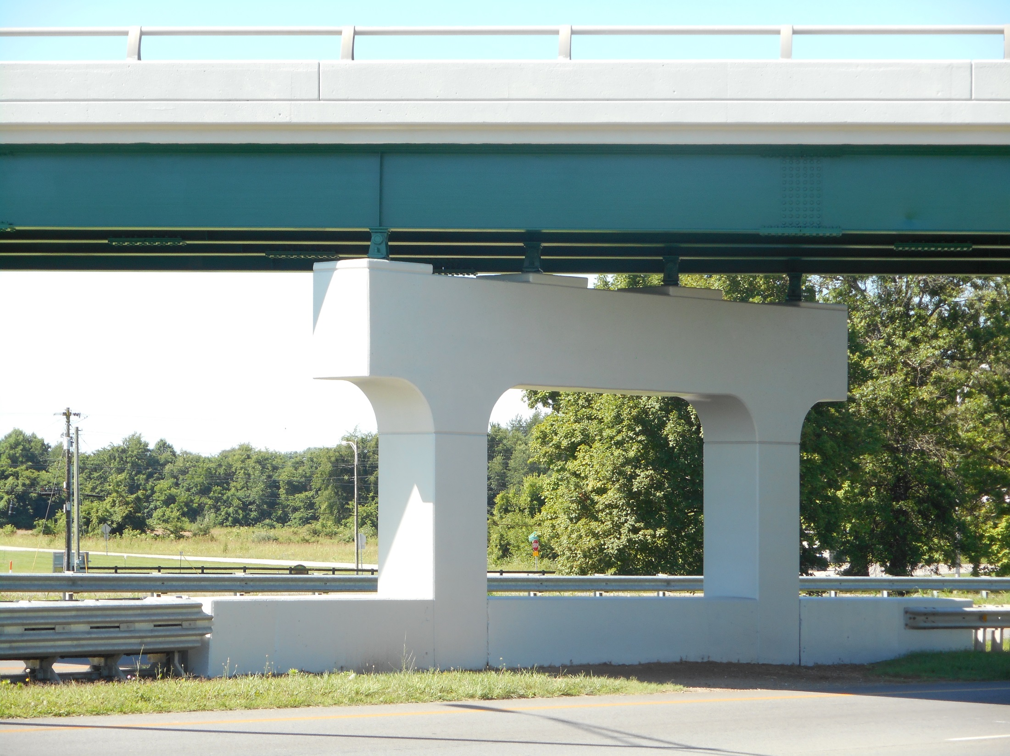

Slide 31
PREVENTIVE MAINTENANCE INSPECTION
BY
MIKE BAASE

Slide 32
Inspection.
Debris Removal: Visual Inspection
Stratified Rust or Pack Rust Removal: Visual Inspection and Scraper Test any surface cleaned to SSPC SP2 will be inspected by a dull scraper test to ascertain adherence of existing coating and a hammer test for tightness of pact rust.
Power Washing: Visual Inspection
Concrete Coating:
Prime Coat Application Check for dry film thickness*, and defects in paint
Finish Coat Application Check for dry film thickness*, paint appearance,
color and quality of application.
*Destructive DFTs shall be used. Contractor shall repair all test locations,
cost will be considered incidental to the contract.
Bearing Greasing: Visual Inspection.

Slide 33
INSPECTION
Debris Removal: Visual Inspection
Stratified Rust or Pack Rust Removal: Visual Inspection and Scraper Test any surface cleaned to SSPC SP2 will be inspected by a dull scraper test to ascertain adherence of existing coating and a hammer test for tightness of pact rust.
Power Washing: Visual Inspection
Concrete Coating:
Prime Coat Application Check for dry film thickness*, and defects in paint
Finish Coat Application Check for dry film thickness*, paint appearance,
color and quality of application.
*Destructive DFTs shall be used. Contractor shall repair all test locations,
cost will be considered incidental to the contract.
5. Bearing Greasing: Visual Inspection.

